Slide 1
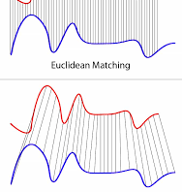
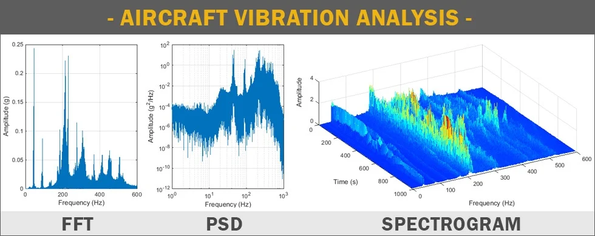
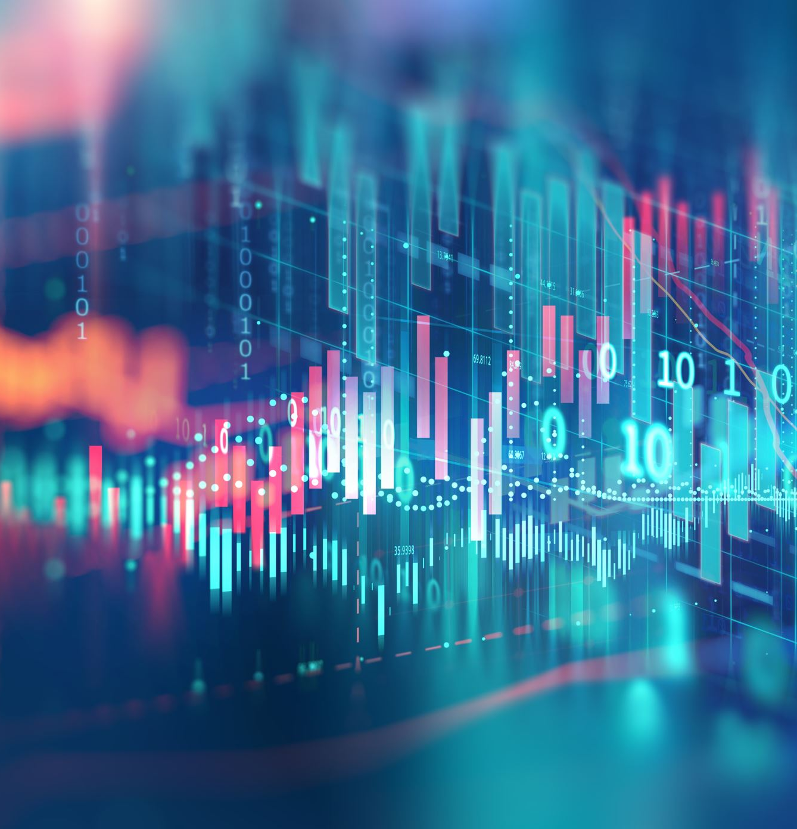
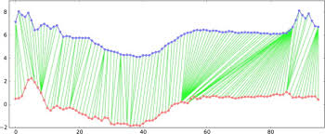

Slide 2
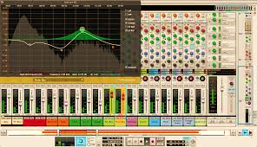

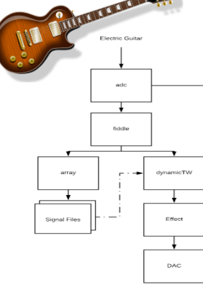
Dynamic Time Warping Triggered Guitar Effects Platform
In live performance, guitar effect pedals are a versatile yet limiting asset, requiring presence of mind on the part of the performer. This platform offers an automatic solution to the restrictions that guitar effect pedals present.
System Architecture:
read in a guitar signal during the ‘learning’ phase and isolate subsections of a performance needed to generate the DTW learned-threshold.
then implement an analysis based on a modified dynamic time warping (DTW) algorithm, to compare the DTW cost function of incoming live audio against the cost-thresholds determined in the pre recording phase.

Slide 3
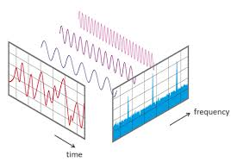
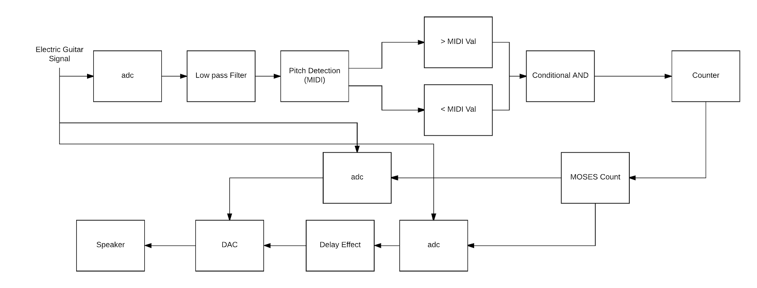
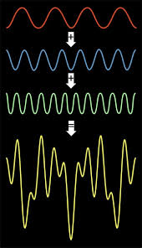
Dynamic Time Warping External:
Compare Incoming live signal with sub signal of one of the recorded performance
When LCP value is less than or equal to the LCP obtained from learning phase, trigger guitar effect
This automation was achieved through the use of Pure Data, a GUI for audio manipulation applications, with embedded Python externals. When the algorithm detects a match, the platform runs the ‘pure’ digitalized audio signal through custom made PD effects patches!
Feed in two song performances for learning phase and obtain Least Cost Path (LCP) for each sub signal

Slide 4
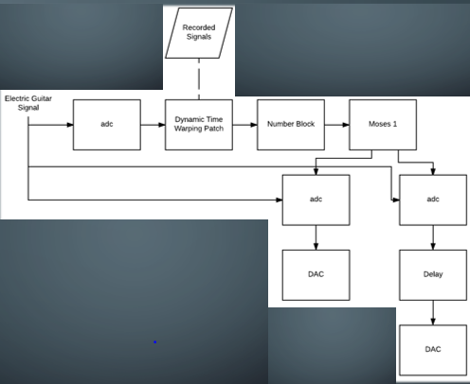
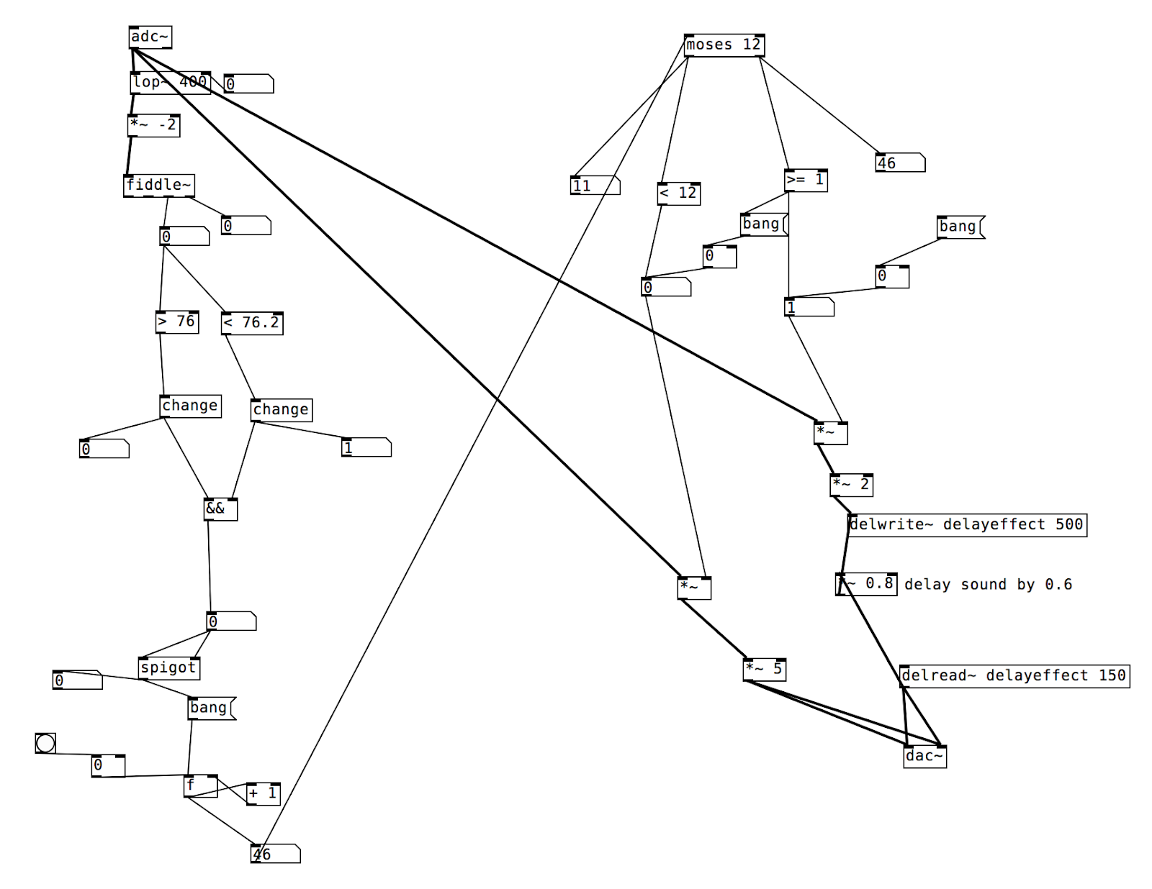
How It works:
This automation was achieved through the use of Pure Data, a GUI for audio manipulation applications, with embedded Python externals. When the algorithm detects a match, the platform runs the ‘pure’ digitalized audio signal through custom made PD effects patches!
Dynamic Time Warping External:
Feed in two song performances for learning phase and obtain Least Cost Path (LCP) for each sub signal
Compare Incoming live signal with sub signal of one of the recorded performance
When LCP value is less than or equal to the LCP obtained from learning phase, trigger guitar effect

Slide 5
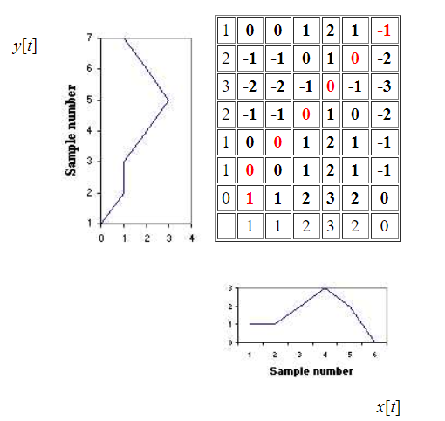
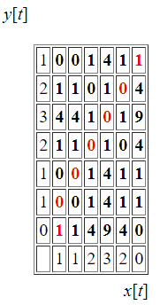
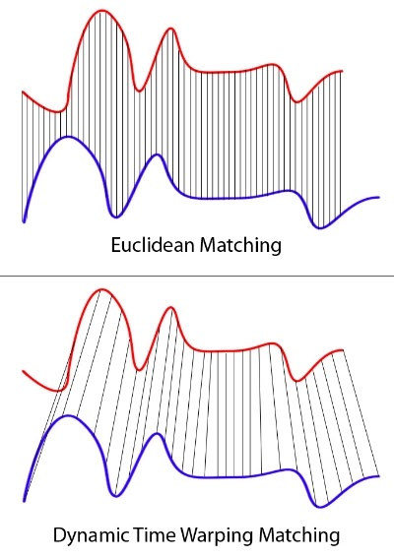
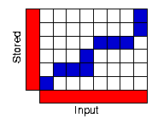
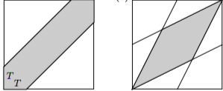
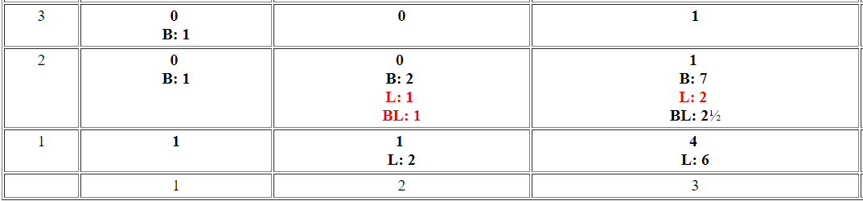
DTW Path
The process can be thought of conceptually as arranging the two sequences on the sides of a grid
Each cell within the grid will be filled in with a distance measure comparing the corresponding elements of the two sequences

Slide 6
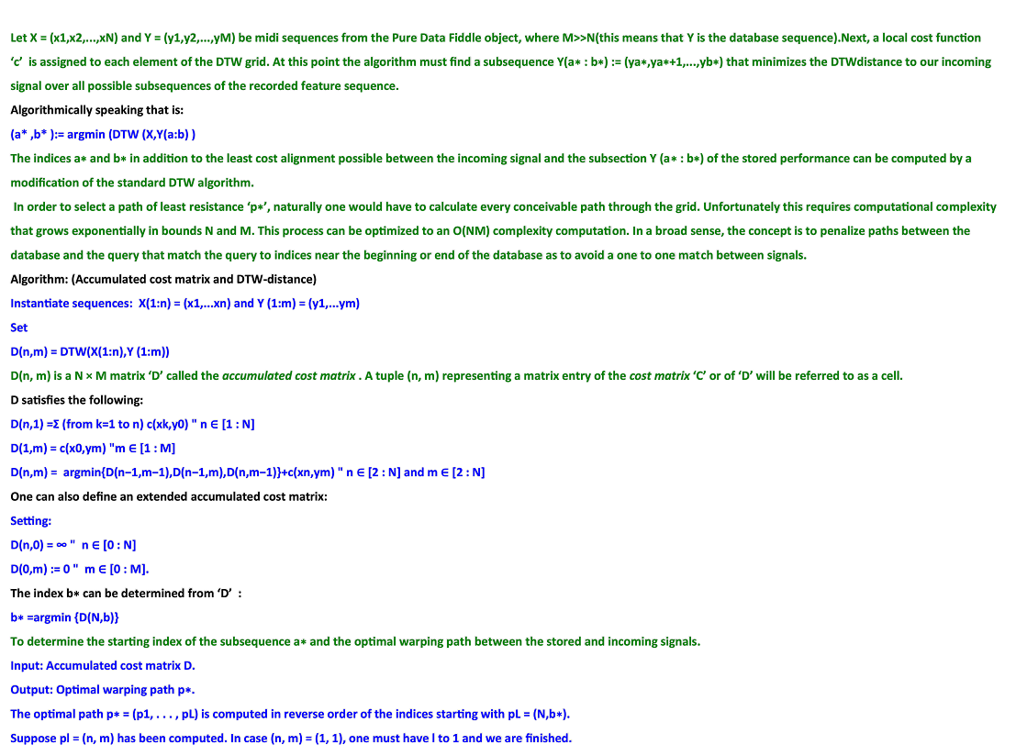

Slide 7
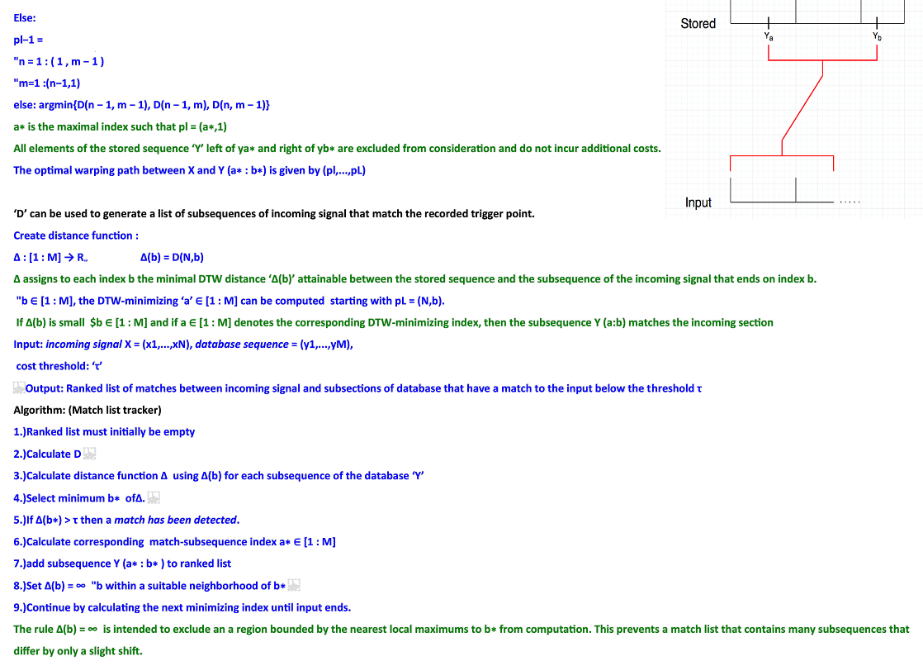

Slide 8
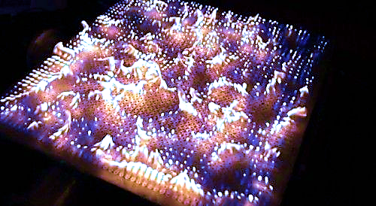
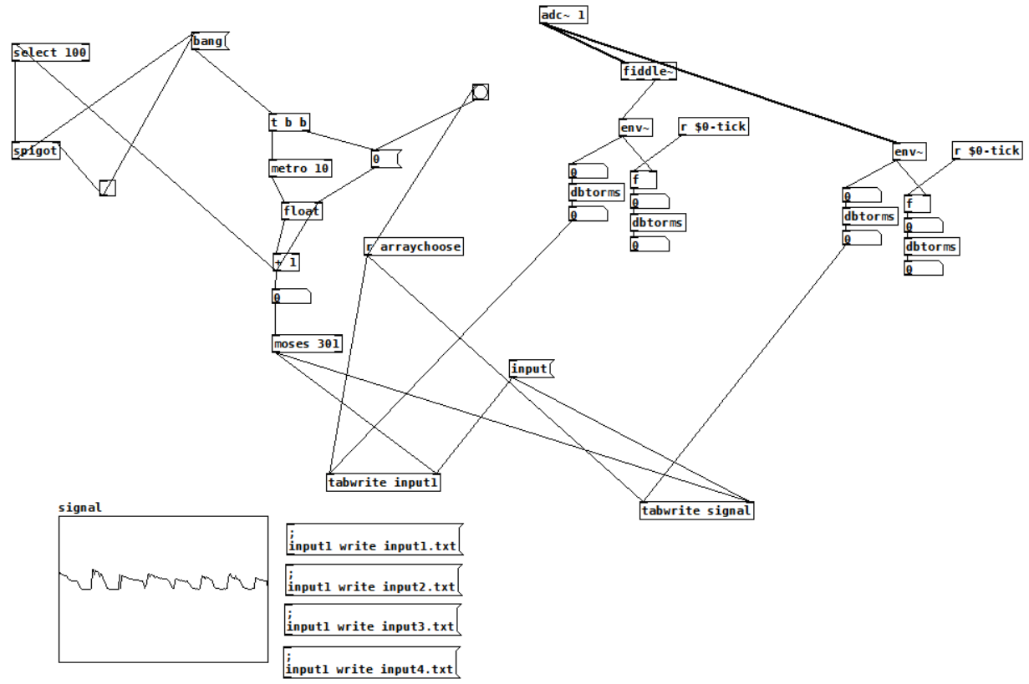
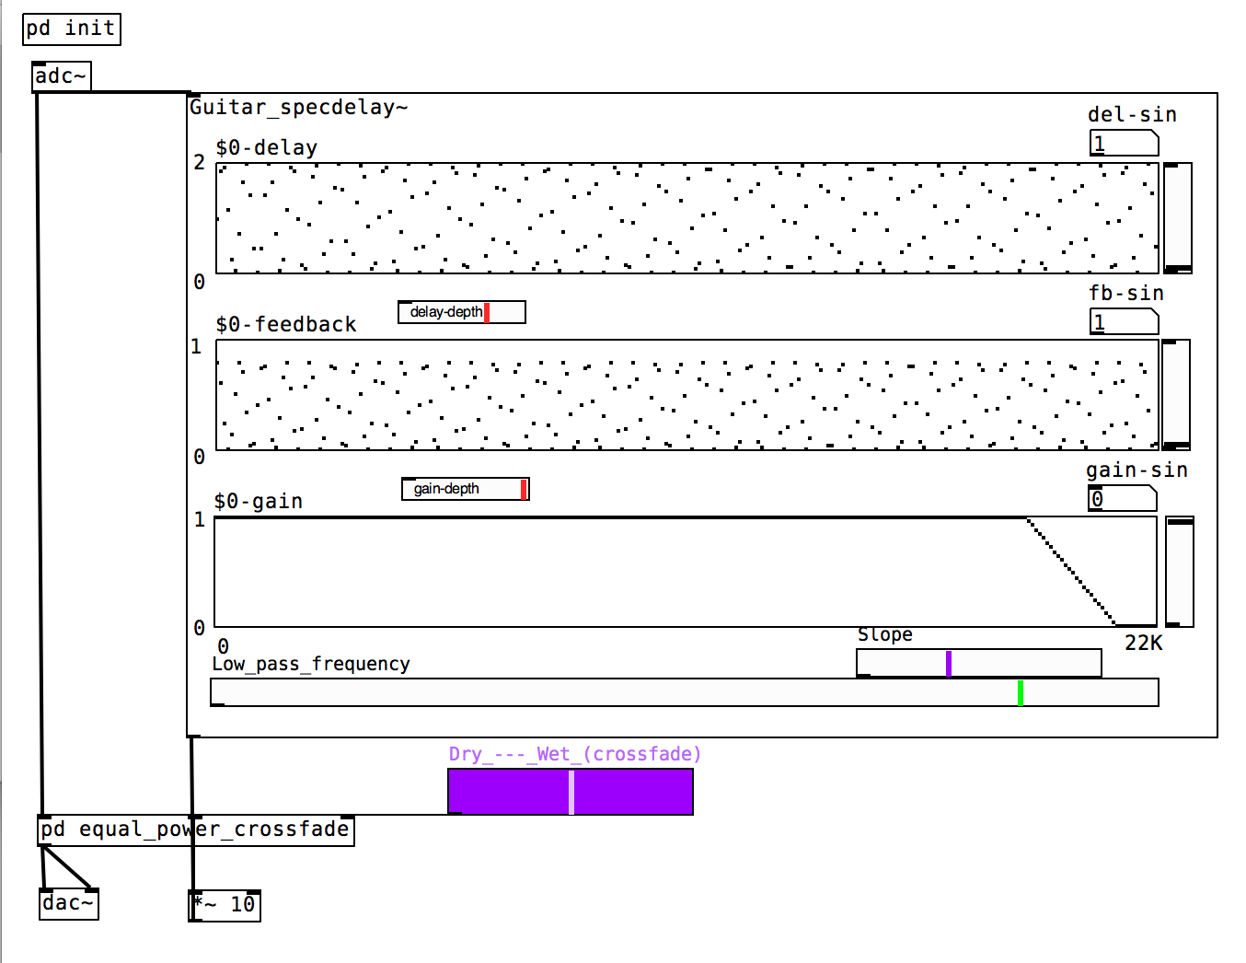

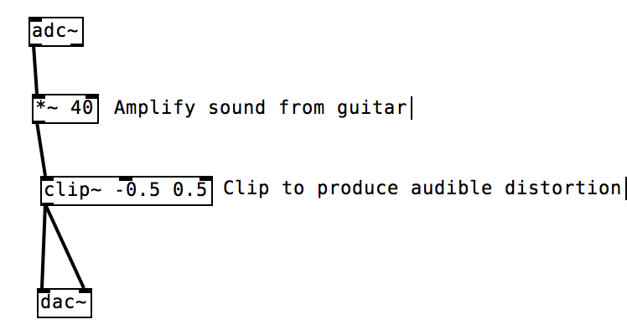
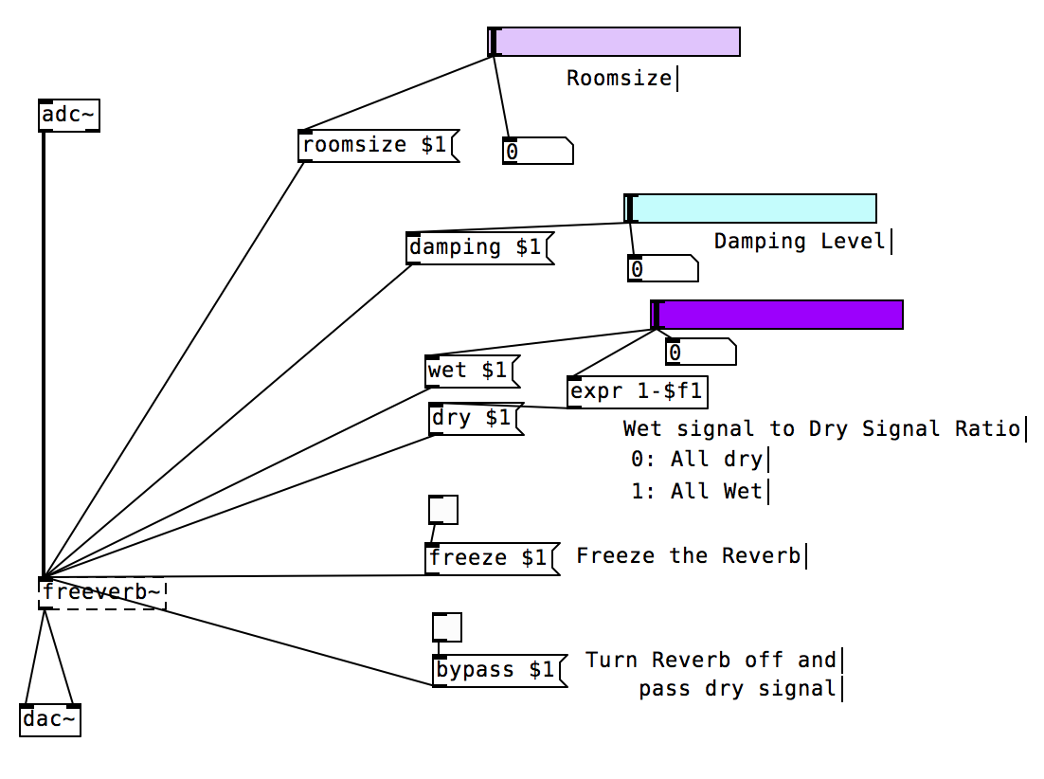
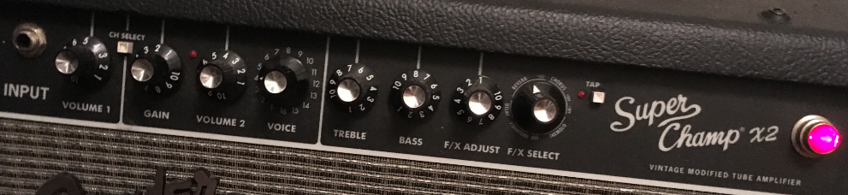
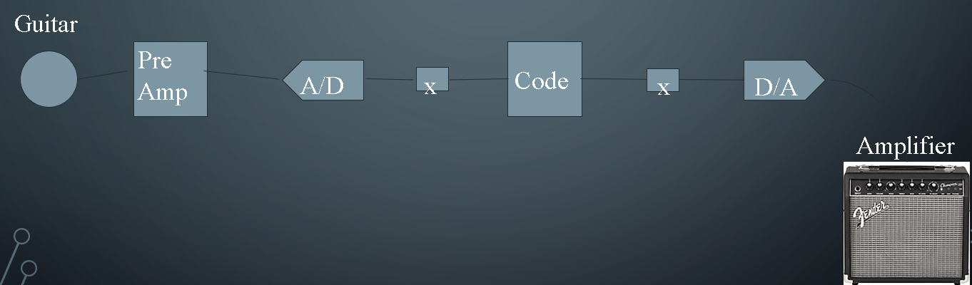
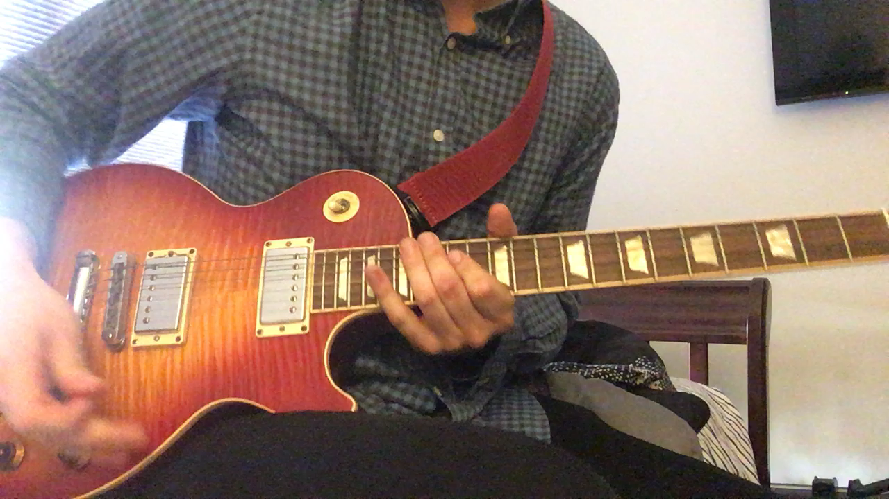
Recording (.wav) Patch: Reverb Patch Spectral Delay Patch (visible part of)Fuzz Patch
Signal sent DI into Scarlet 2i2 to be ported into pure data and then back out the DAC into a Fender Super Champ X2 FSR 15-watt 1x10" Tube Combo Amp using the settings below and was captured by my I phone's mic.
Pure Data Patch Demos:

Slide 9

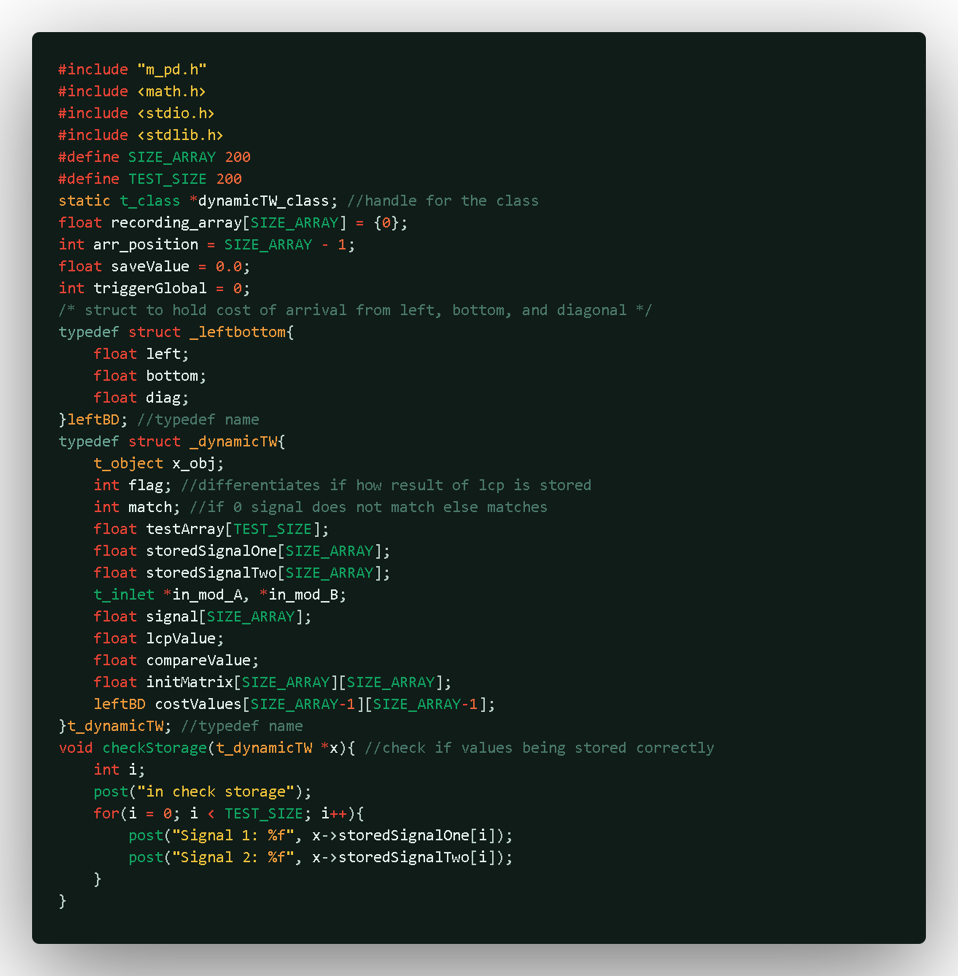
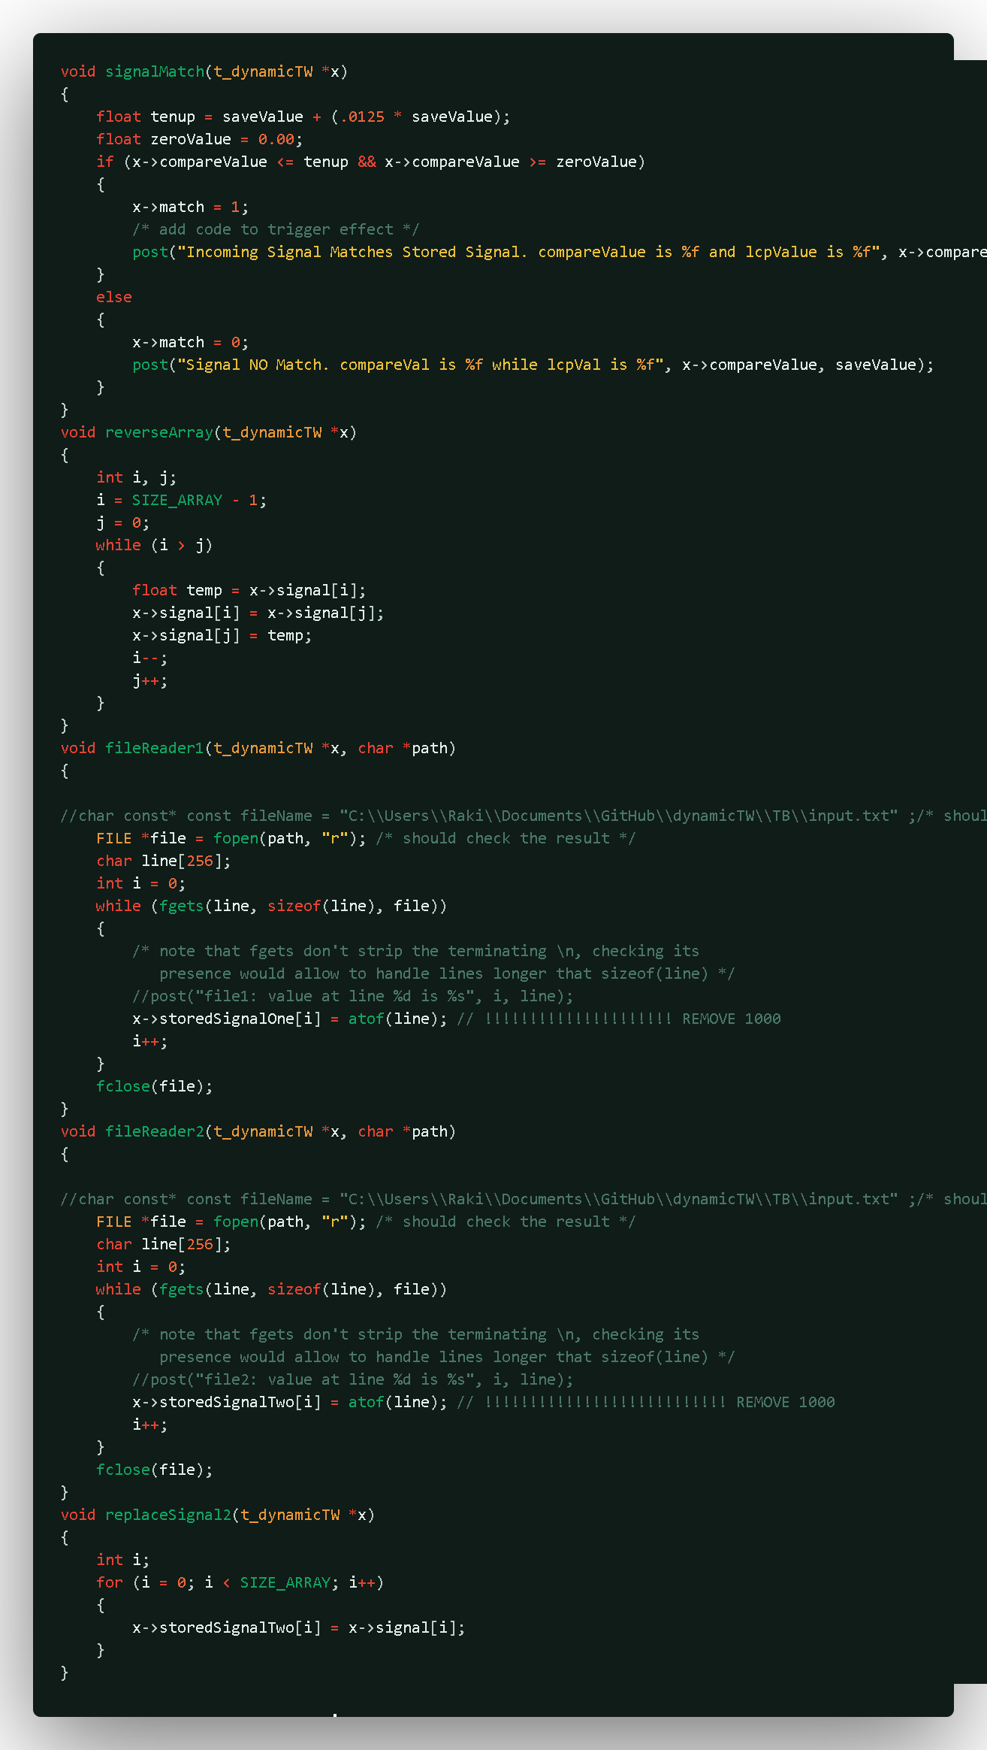
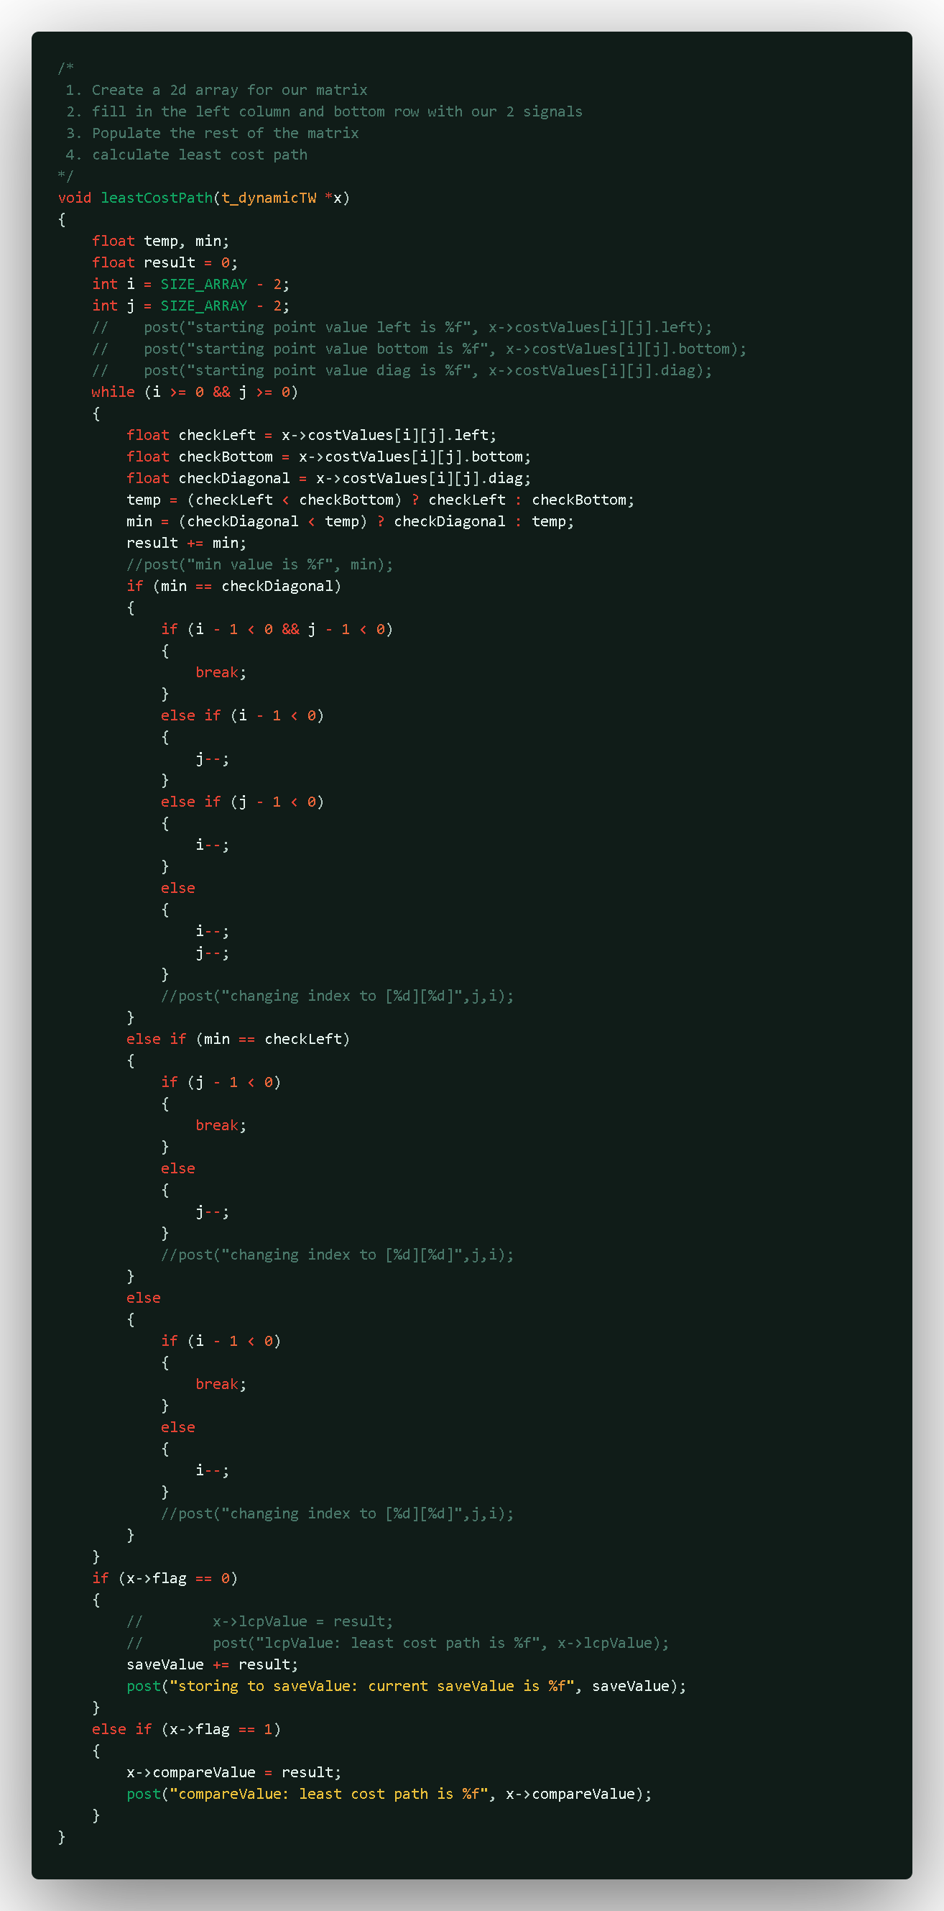

Slide 10
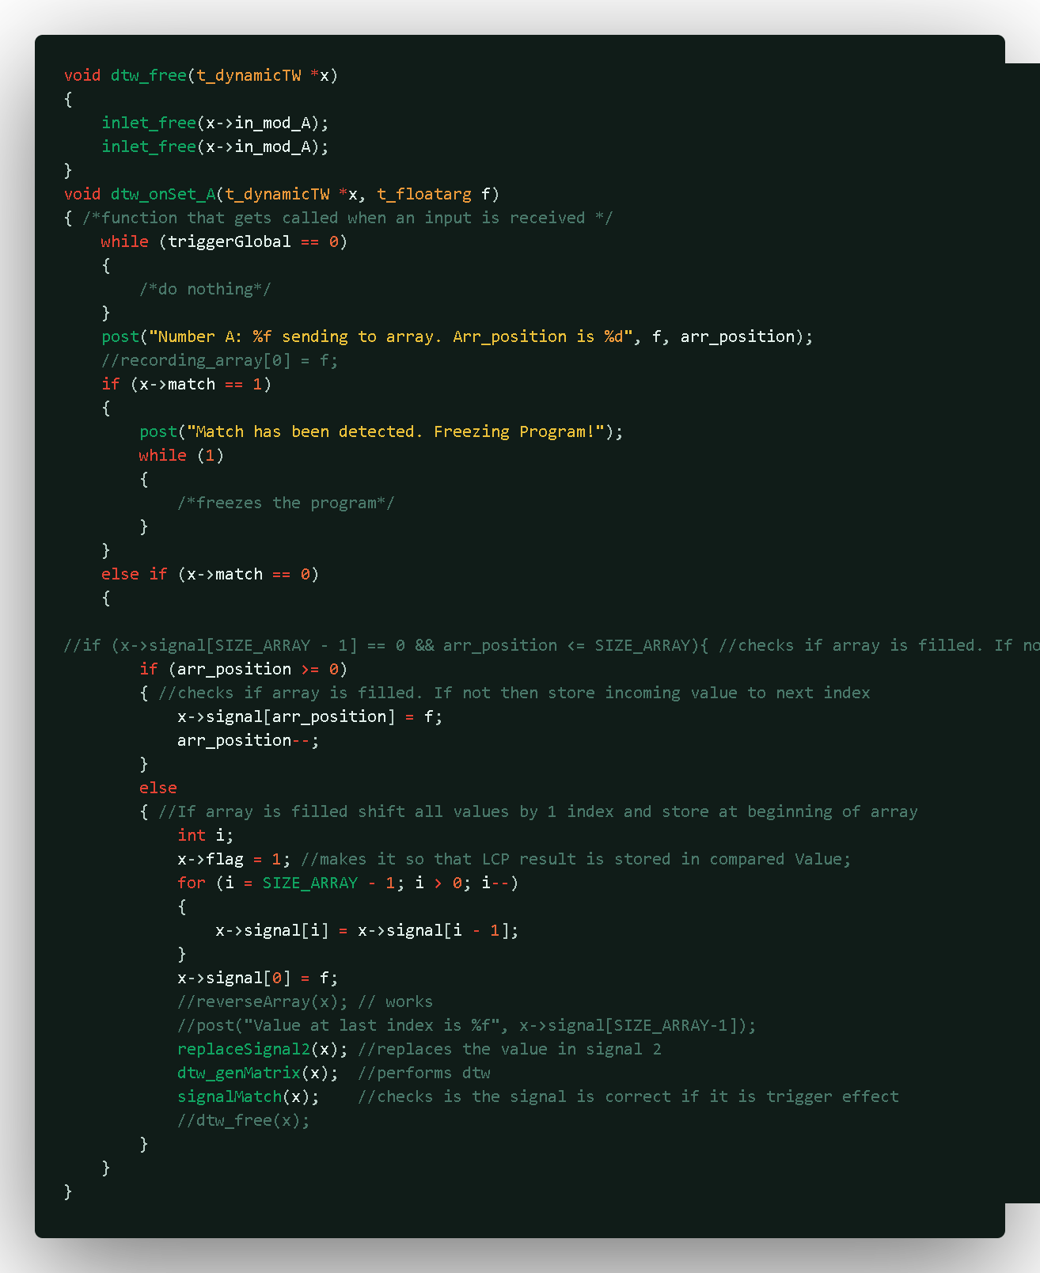
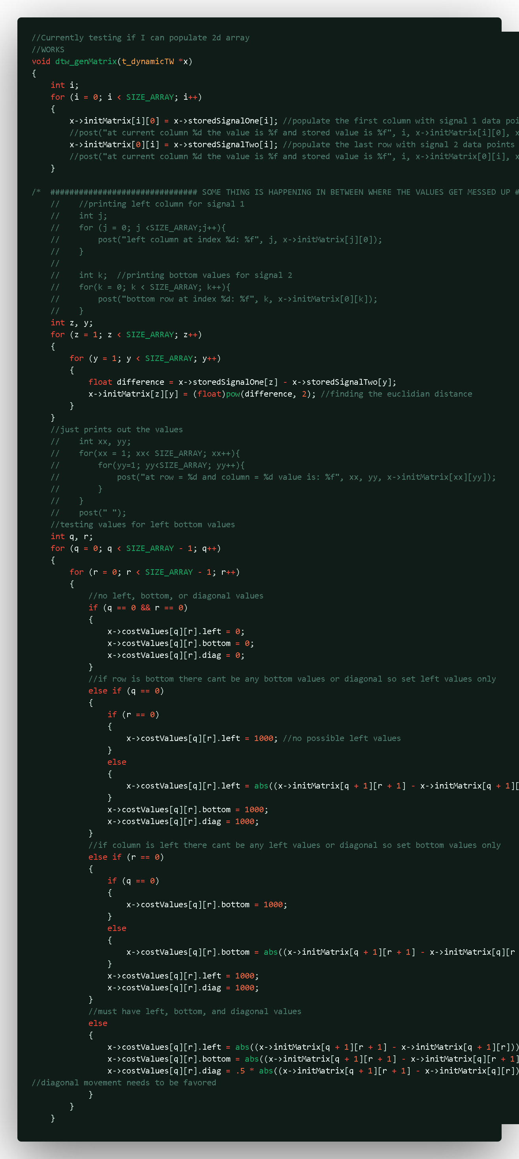
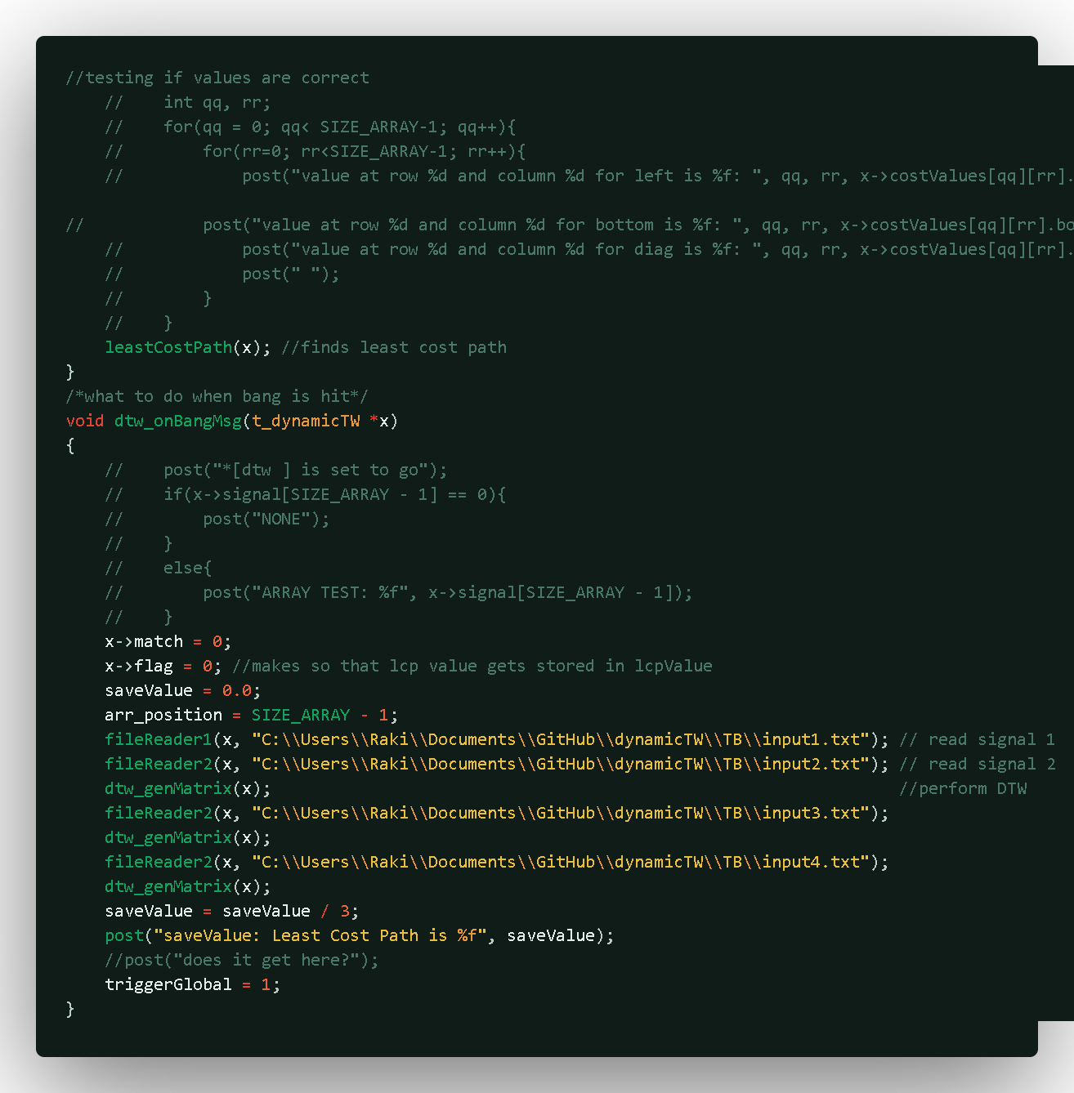

Slide 11
